Slide 1
Sentiment analysis of twitter data

Slide 2
Premise
Language has been an essential part of the human civilizations.
Starting from just caricatures then to scripts its been how knowledge has been passed on and preserved.
As such now with help of machines we make interpretations, translations, speech to text and vice versa.

Slide 3
Objective
The aim here is to create a generalized showcase model which can learn during the training process and then classify.
We have chosen the twitter data from Kaggle for this purpose.
The resulting model should classify if the given tweet’s sentiment is either positive or negative.

Slide 4
Workflow
We clean the data of special chars, hyper links, handle names, emojis.
The data is then transformed into TaggedDocument.
The entire corpus is split into train and test sets.
Doc2Vec is initialized and the training set is used, post that we use build_vocab to build a vocabulary from the training set.
We then convert the training and test data into vectors i.e texts to a matrix of numerical values. Using .infer_vector methodsover the model.
LogisticRegrssion model from sklearn learn is used to train a model and then using it to predict.

Slide 5
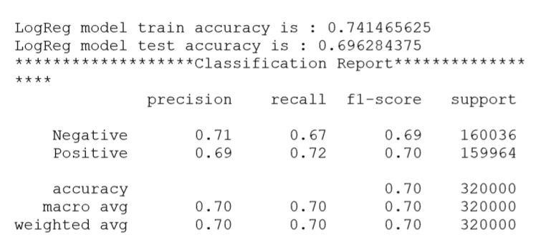
The resulting model is fairly successful in predicting the sentiment with the below results.

Slide 6
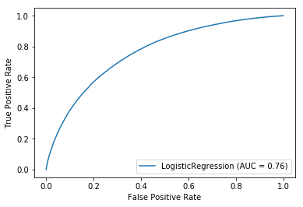

Slide 7
Closing points
Using lemmatization actually lead to reduced performance of the model.
Random forest and Gradient boosting were also tried which either produced similar results or performed less than LogReg.
With sustained effort and essentially trying other avenues will lead to increased performance.

